Slide 1
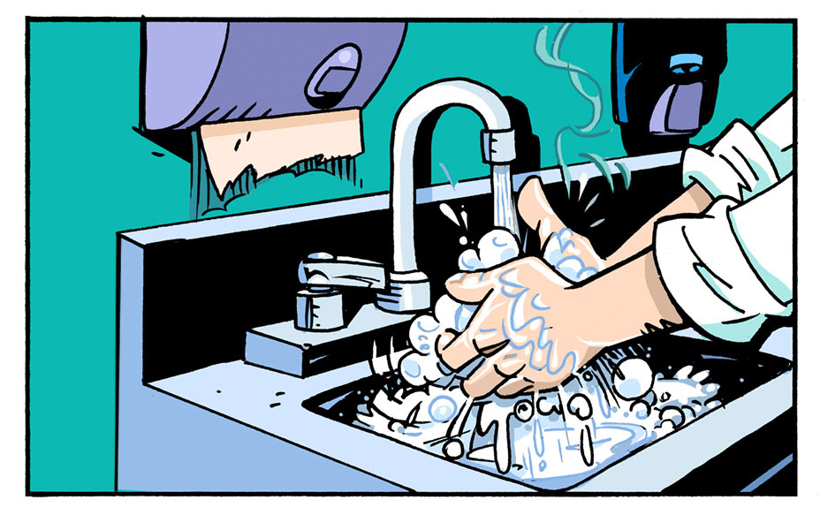
Unit 4
Food Handler Health and Hygiene

Slide 2
Food Handler Health & Hygiene

Slide 3
Hand Washing

Slide 4
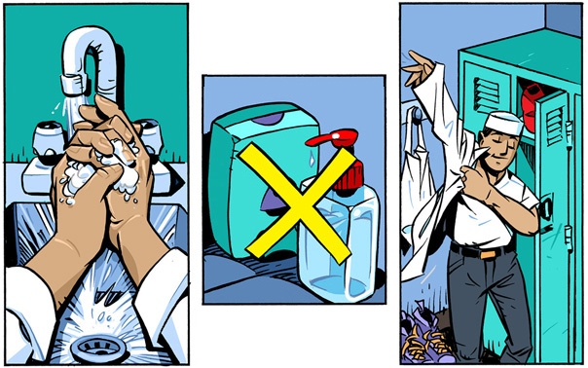
Personal hygiene

Slide 5
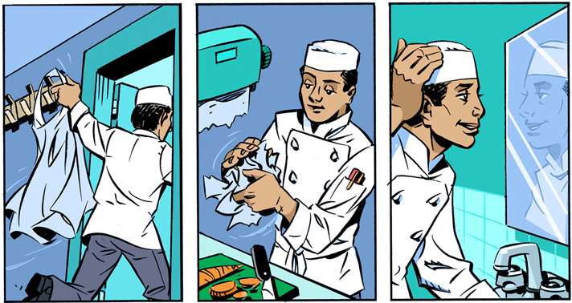
Personal hygiene

Slide 6
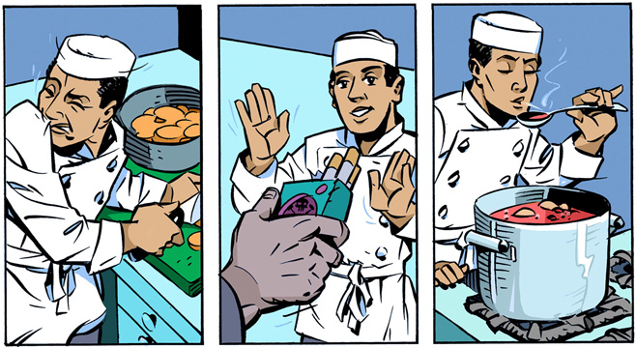
Personal hygiene

Slide 7
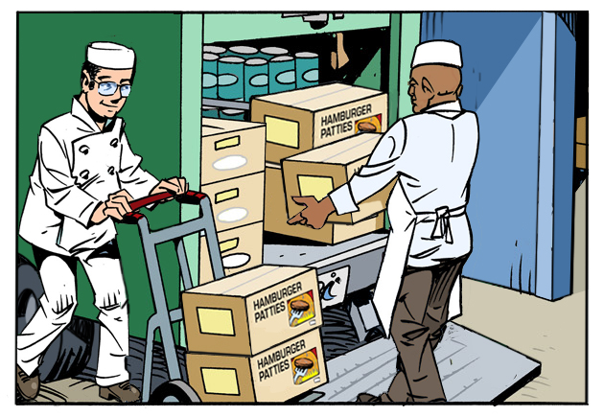
Unit 5
Receiving and Storing Food Safely

Slide 8
Receiving and Storage

Slide 9
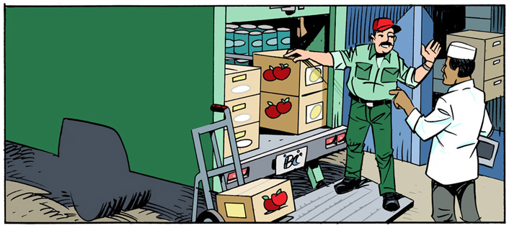
Receiving
Approved Source

Slide 10
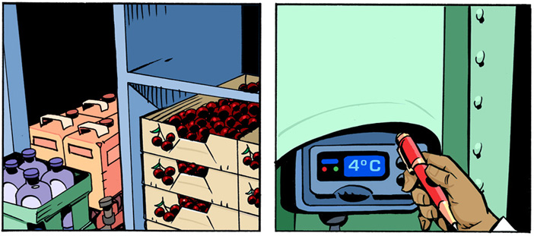
Receiving

Slide 11
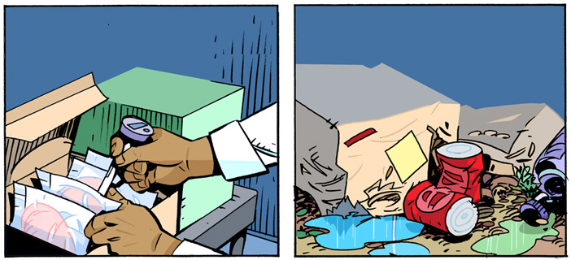
Receiving

Slide 12
Receiving

Slide 13
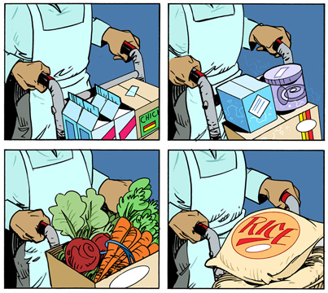
Storing

Slide 14
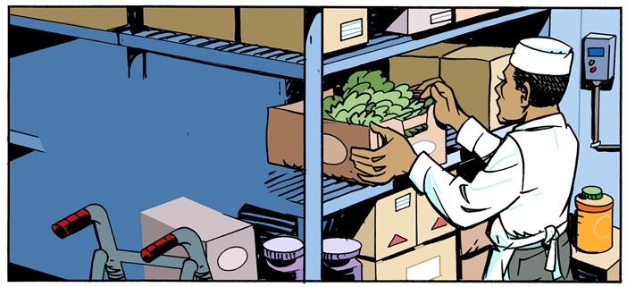
Storing

Slide 15
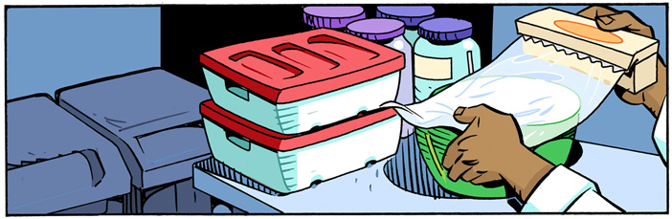
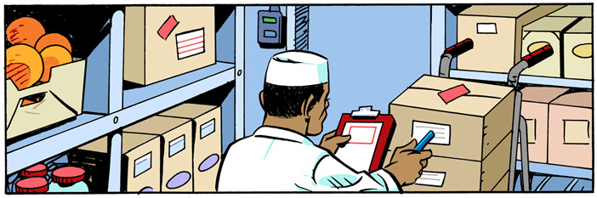
Storing

Slide 16
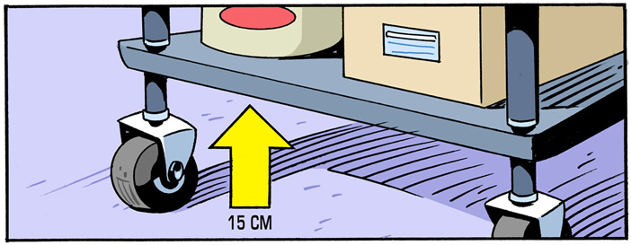
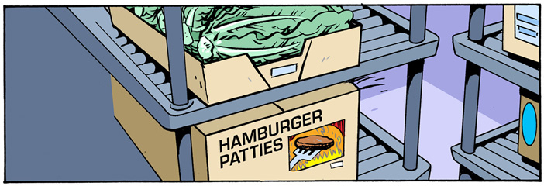
Storing

Slide 17
Storage

Slide 18
Unit 5 Review

Slide 19
1. When receiving a shipment of food, the internal temperature of frozen food should be:
  -18°C (0°F)
  4°C (40°F)
  60°C (140°F)

Slide 20
2. Food should only be accepted from approved sources because they:
  are subjected to regular inspections
  provide easy credit term for restaurants
  have adequate storage space on the vehicle

Slide 21
3. A food shipment of a box of frozen chicken breasts, four cartons of milk, a crate of raw carrots and three bags of flour has just arrived. What should be put away first? Second? Third? Last?
  frozen chicken breasts
  cartons of milk
  bags of flour
  crate of raw carrots

Slide 22
4. The first in, first out (FIFO) rule means that food is organized so that:
  frequently used items are close to the door
  the first products loaded onto the delivery truck are unloaded first
  older stock is used before new stock

Slide 23
You are receiving a shipment of potentially hazardous refrigerated food. The temperature gauge on the delivery truck is not working. What should you do first?
  reject the shipment
  check the temperature of the food
  ask the driver how long the gauge has been broken

